Slide 1

BELARUSIAN STATE
ECONOMIC UNIVERSITY
DIGITAL UNIVERSITY
© BSEU 2025 WWW.BSEU.BY

Slide 2

The Normative Basis for Digital Transformation
Decree of the President of the Republic of Belarus (December 21, 2017 No. 8)
Concept of digital transformation of processes in the education system of the Republic of Belarus for 2019–2025 (The Minister of Education of the Republic of Belarus, March 15, 2019)
Conceptual approaches to the development of the education system of the Republic of Belarus until 2020 and for the future until 2030 (Order of the Minister of Education of the Republic of Belarus, November 29, 2017 No. 742)
On experimental and innovative activities in the 2024/2025 academic year (Order of the Ministry of Education, August 13, 2024 No. 345)
Program for development of the educational institution «Belarus State Economic University» for 2021–2025
Concept of informatization of the educational institution «Belarus State Economic University» for 2021–2025
State program «Digital development of Belarus» for 2021–2025 (Resolution of the Council of Ministers of the Republic of Belarus, February 2, 2021 No. 66)
© BSEU 2025 WWW.BSEU.BY

Slide 3
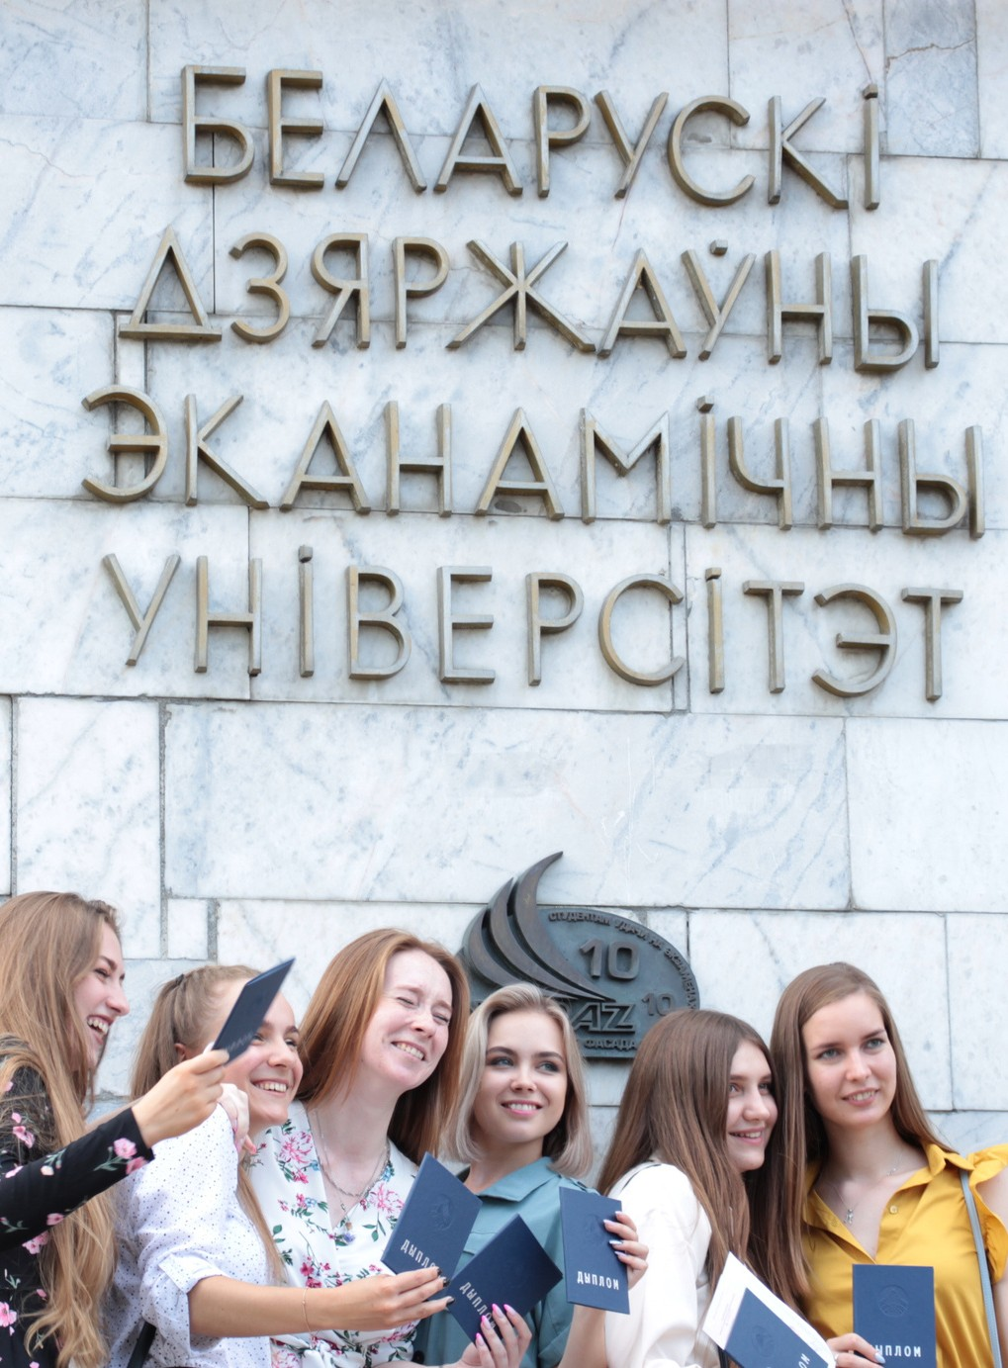
DIGITAL UNIVERSITY
a common environment of digital services and educational innovations, adapted to the processes and goals of the university
MISSION
►improving the quality of the educational process including all the elements of the educational process, research and management
GOALS
►the development of educational technologies, interactive learning means, multimedia platforms of distant providing of educational content
►the formation of an automated information-analytical system of data collection, storage, processing and analysis
© BSEU 2025 WWW.BSEU.BY

Slide 4
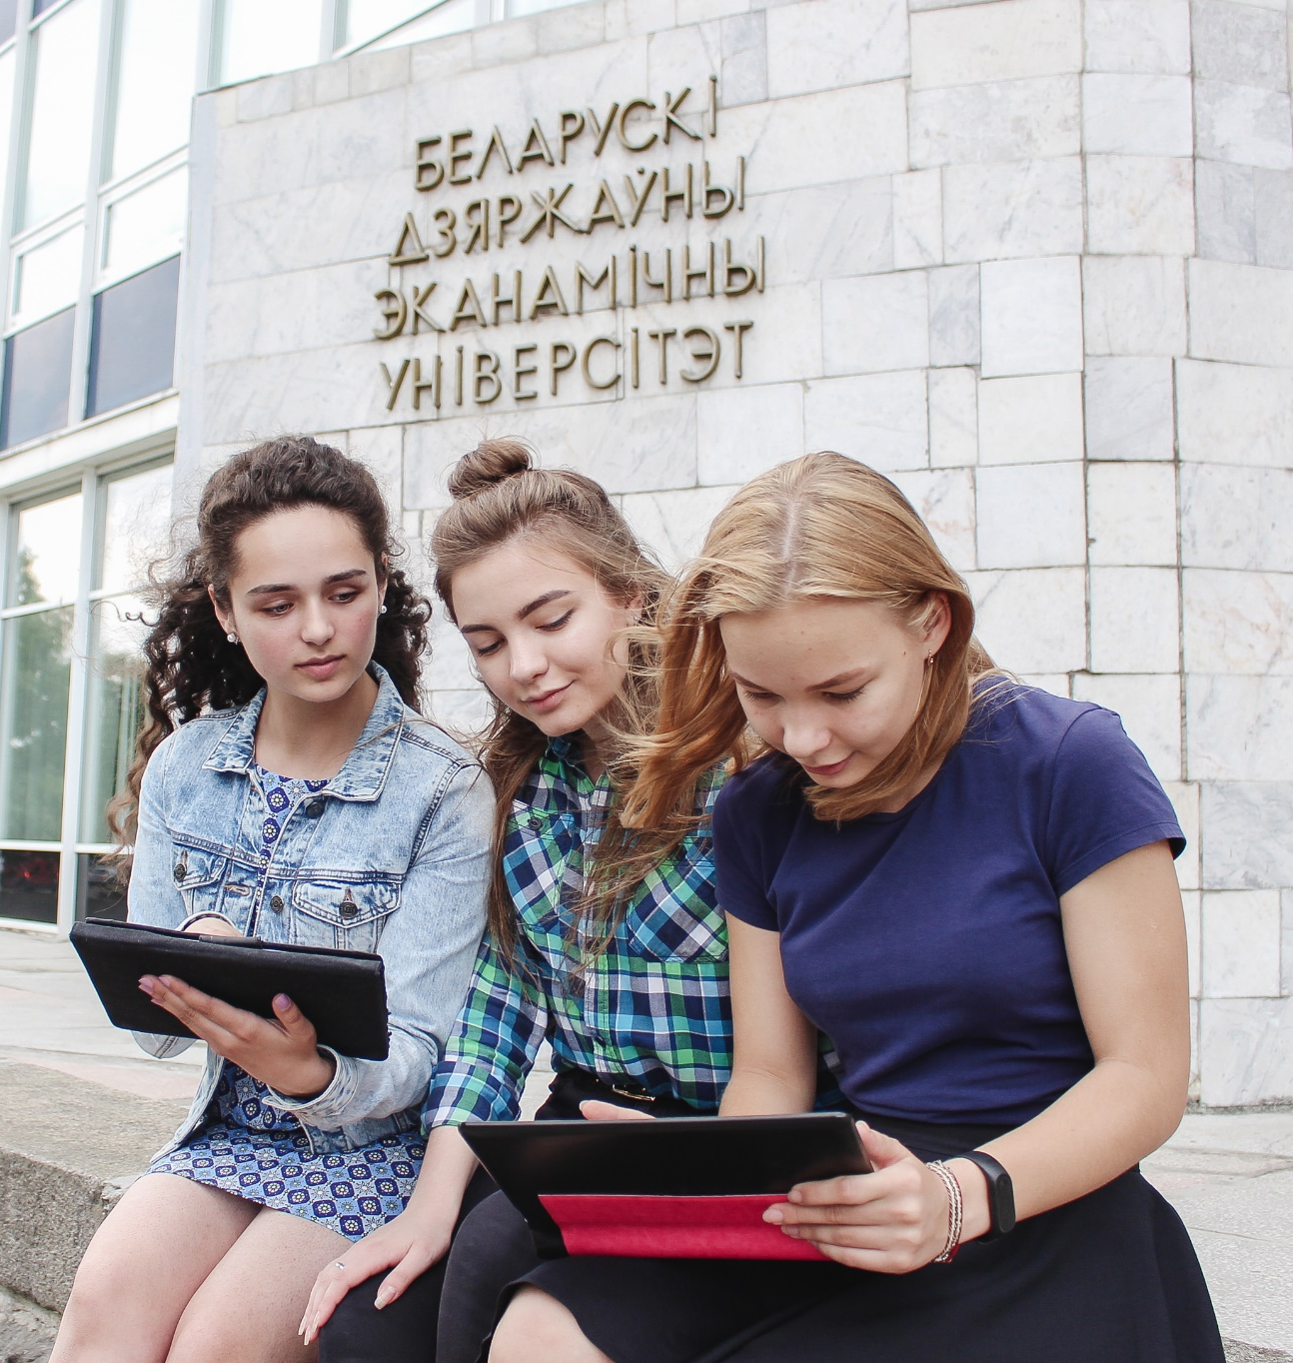
Principles of Digital Transformation of the Learning Process
PERSONALIZATION
Opportunity for students to form their own educational path
INTERACTIVITY
Constant communication between the participants of the educational process
PRACTICAL ORIENTATION
Formation of professional competences relating to future occupation
ADAPTIVITY
ADVISABILITY
Selection and application of technologies for guaranteed achievement of person-centered learning goals
Choice of content and ways of its assimilation in accordance with individual needs
INCLUSIVENESS
Taking into account all specific features of the educational process participants
SATURATION
Relevance and completeness of information resources
MULTIMEDIA
Use of various means and forms of information presentation
FLEXIBILITY
Regular control and updating of the educational process
© BSEU 2025 WWW.BSEU.BY

Slide 5
KEY COMPONENTS OF DIGITAL UNIVERSITY
PERSONNEL
INFRASTRUCTURE
INFORMATION RESOURCES
© BSEU 2025 WWW.BSEU.BY

Slide 6

Digital Transformation Capacity of BSEU
more than 300 PhDs, associate professors
more than 50 doctors, professors
constant professional development of the teaching staff
use of ICTs in the educational process
server equipment (hyperconverged cluster of 3 physical servers)
300 Mbit/sec – speed of Internet access
23 Wi-Fi hotspots
about 1000 printers, MFDs, copiers
more than 70 switchboards, 1 router
100% Internet connection of computers
42 portable multimedia projectors
31 computer labs
worldwide online educational platforms (Yandex Telemost, etc.)
1764 electronic educational and methodological complexes in the e-library database
122 equipped lecture rooms
more than 375 digital workplaces in the departments
4,5 thousand e-learning courses available on three educational portals
an extensive network of corporate information resources (website, e-mail, educational platforms, library of educational videos, electronic library)
more than 1000 clips
of educational videos
61 lecture rooms are equipped with interactive panels
4 lecture rooms – with multimedia projectors and interactive boards
5 lecture rooms – with wide-screen monitors
56 lecture rooms – with multimedia projectors
© BSEU 2025 WWW.BSEU.BY

Slide 7
Digital Infrastructure of the University
Server system for storing and transferring information
Computer equipment, interactive panels, videoconferencing equipment, multimedia projectors
More than 1500 PCs connected to the local and corporate network
Digitalized department working places
Computer equipped lecture rooms
Recording studio for broadcasts, lectures, and online courses for professors
© BSEU 2025 WWW.BSEU.BY

Slide 8

Digital Learning Environment
Educational portals of BSEU
elearning.bseu.by
i.bseu.by
test.bseu.by
open.bseu.by
Information resources
Electronic scientific library
Electronic vacancy exchange
Faculty
e-resources
Educational and methodical
e-complexes
BSEU
student's profile
Library of educational video materials
  Information resources generated in-house:
  Electronic catalogue with online access. Total number of bibliographic records – more than 785000
  Electronic library contains about 72000 full-text documents (Electronic educational and methodical complexes, abstracts of theses, articles, conference materials etc.)
  More than 10 full-text databases of world-known aggregators, information portals and electronic periodicals
  Fulfillment of information requests for electronic delivery of documents from electronic library collections
  Integrated plug-ins of “Znanium.com” and “BOOK.ru” into the BSEU educational portal
  Reading rooms with free Wi-Fi access
© BSEU 2025 WWW.BSEU.BY

Slide 9

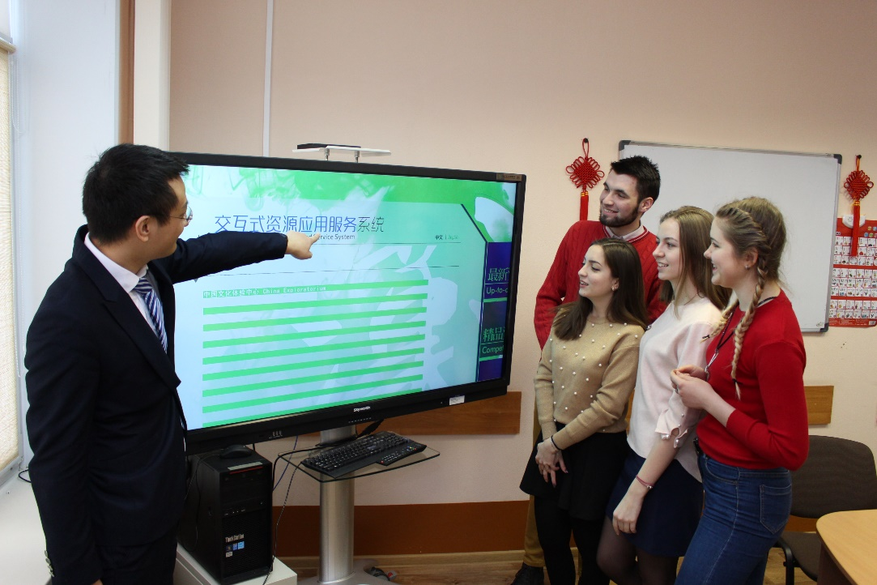
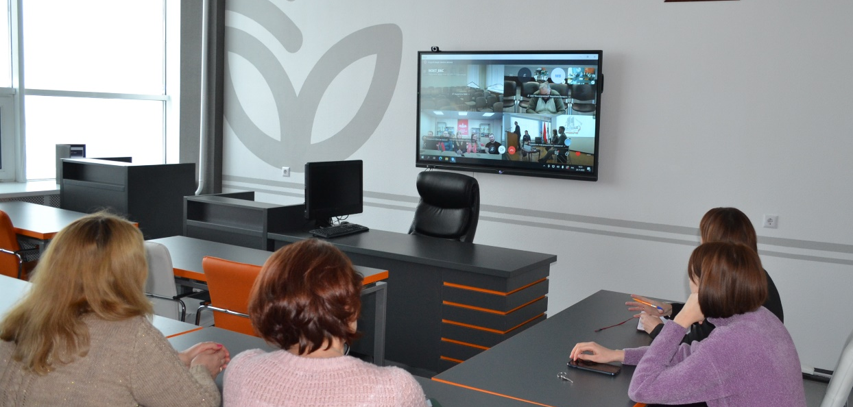
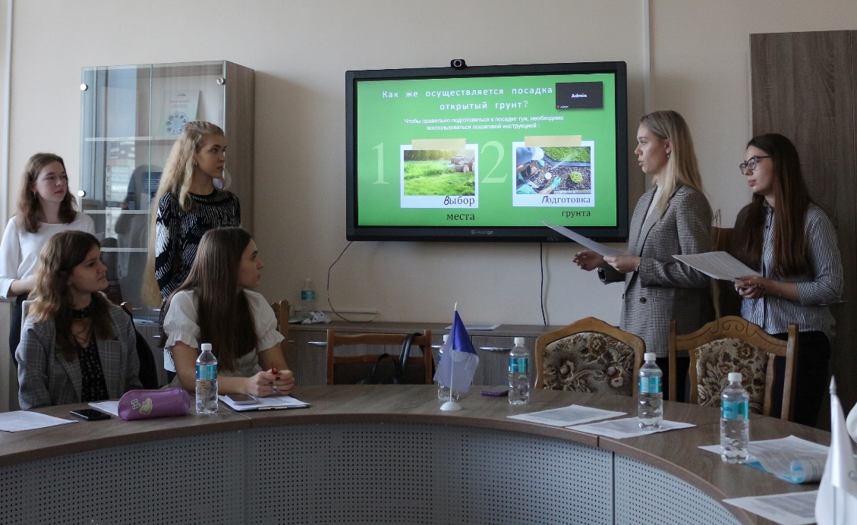
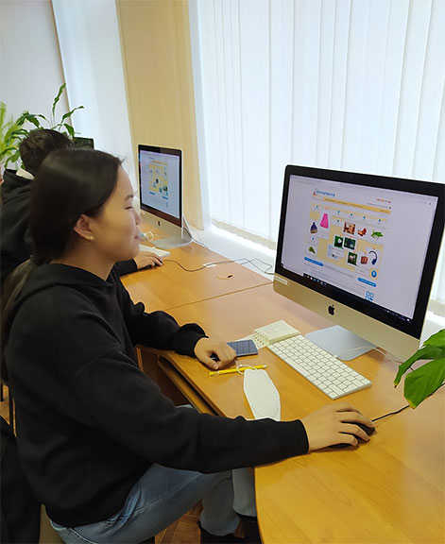
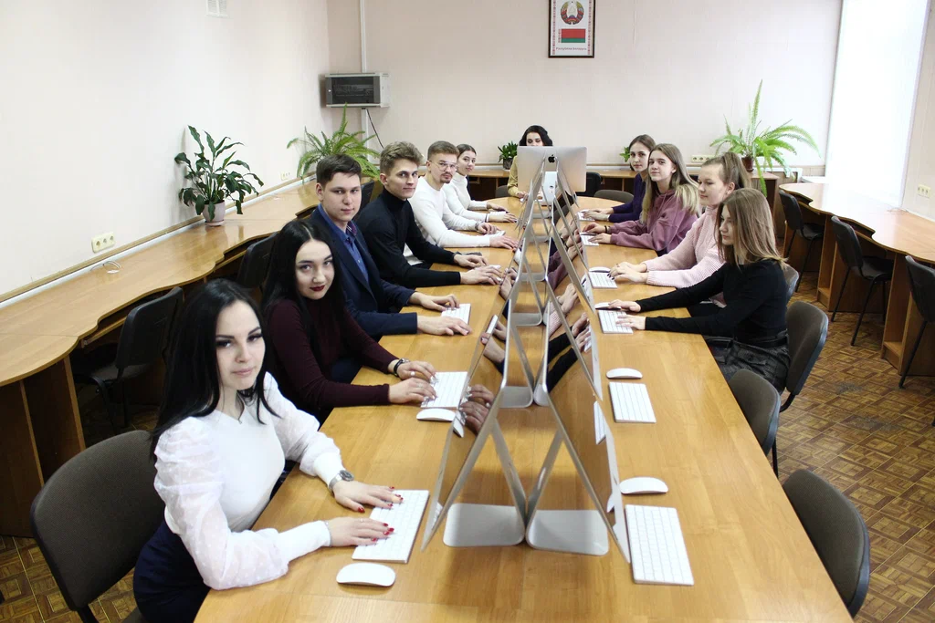
BSEU
EDUCATIONAL PORTALS
elearning.bseu.by
for all educational programs of BSEU (general and advanced education)
test.bseu.by
i.bseu.by
e-learning courses for distance learning students
open.bseu.by
for educational programs of part-time education
for conducting interuniversity Olympiads, as well as career guidance work with school students
© BSEU 2025 WWW.BSEU.BY

Slide 10
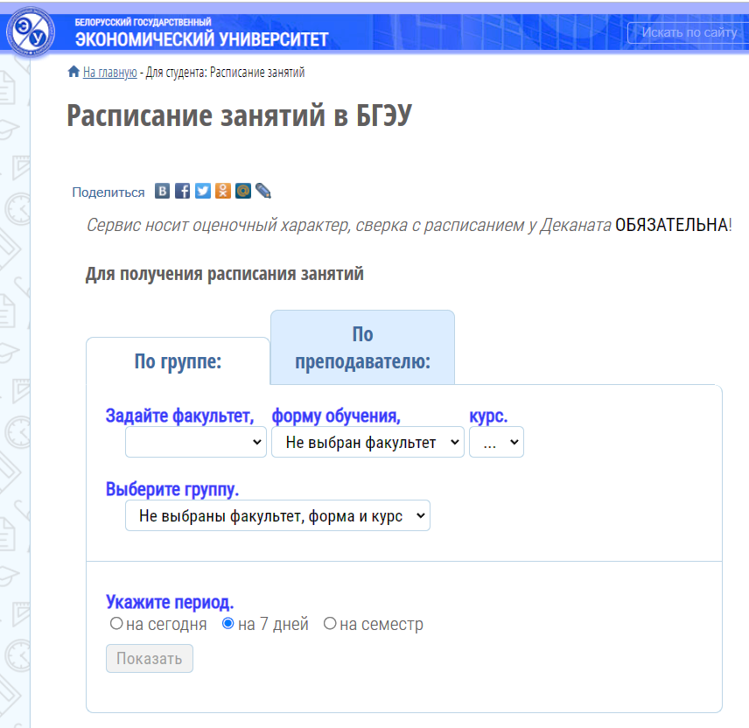
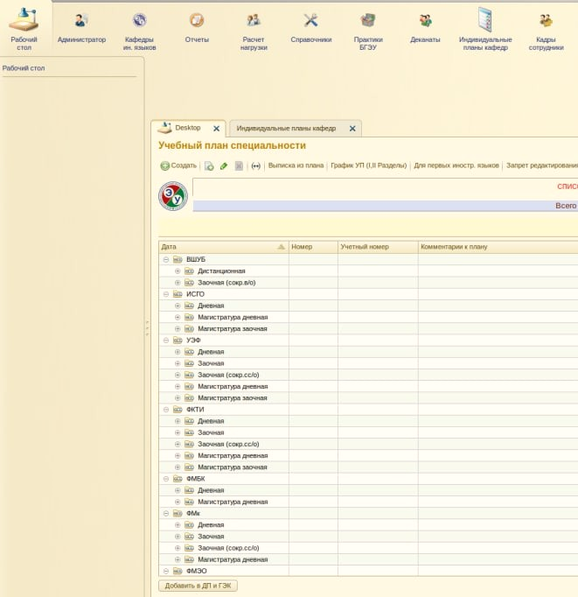


Digitalization of University Management Processes
AUTOMATED TRAINING WORKLOAD RECORD ON THE BASIS OF «1C: ENTERPRISE»
standardization of the primary information
EDUCATIONAL PROCESS CONTROL SYSTEM
academic course content control
student activity control on the educational portal
electronic schedule
simplicity of calculation and workload control in departments
optimization of dean's offices work
© BSEU 2025 WWW.BSEU.BY

Slide 11
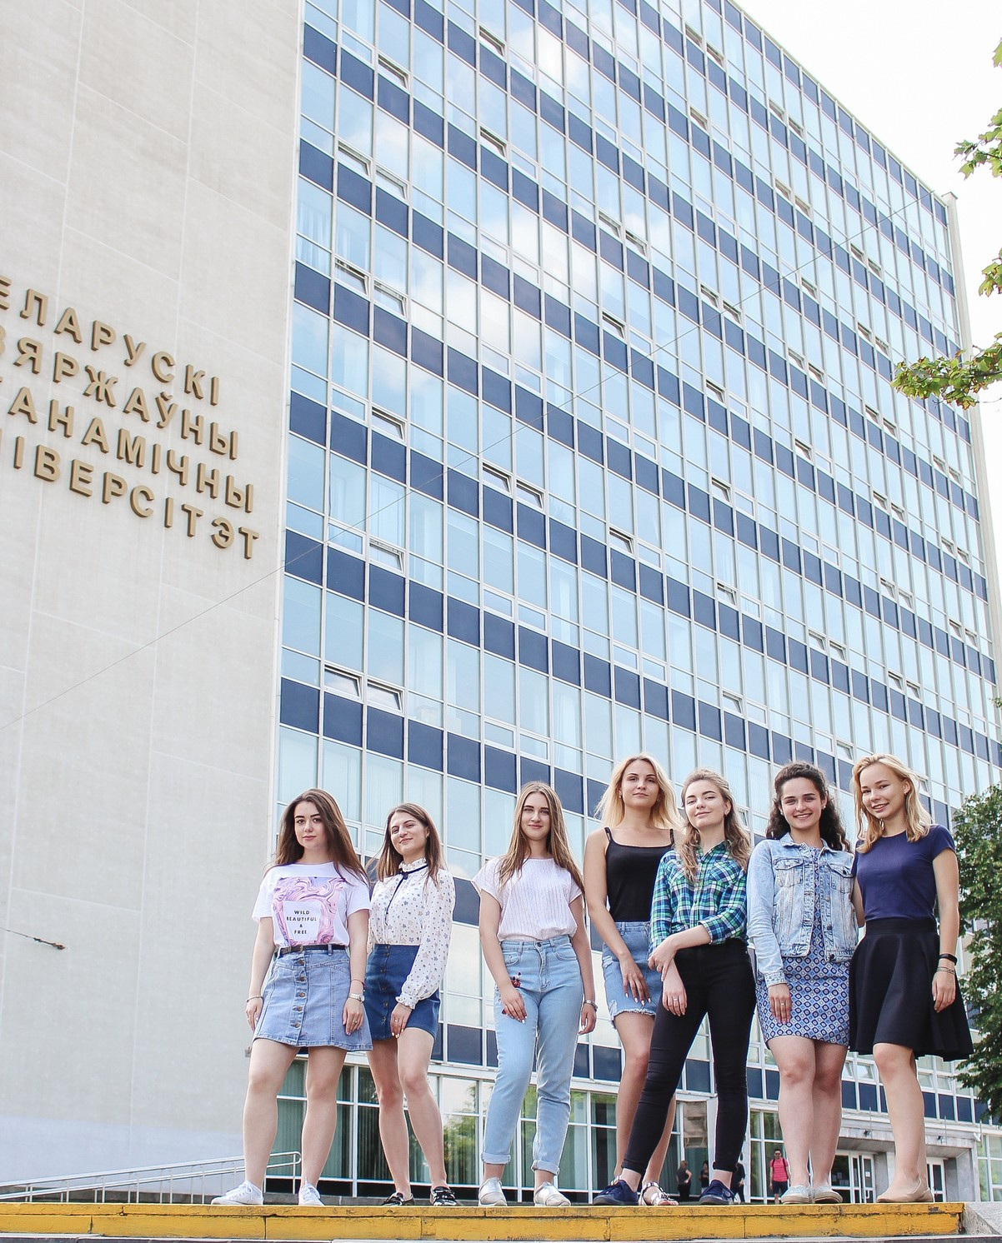
Prospective Trends in University Digitalization for 2024/2025
Ensuring the security of electronic information resources of BSEU
Developing and upgrading of the information and communication infrastructure, the material and technical base strengthening
Improving the processes in the University’s management and financial activities
Providing up-to-date electronic educational content, increasing the number of scientific and educational publications in the BSEU e-library
© BSEU 2025 WWW.BSEU.BY

